Slide 1
TEAM 22
Design
IV
Review
FACE TRACKING

Slide 2
Introduction Problem
A new in-car interaction method?

Slide 3
Introduction Needs
Gesture control!
A object tracking system
A gesture
tracking system
A face tracking system!

Slide 4
Introduction Solution
A real-time illumination robust face tracker

Slide 5
Requirements Customer
Real-time
Accurate
Reliable under different scenarios
focus lose,
sudden illumination change, etc.
Portable

Slide 6
Requirements Engineering
Real-time
Frame rate > 24 fps
Accurate
Precision > 80%
Reliable under different scenarios
Variance < 10%
Portable

Slide 7
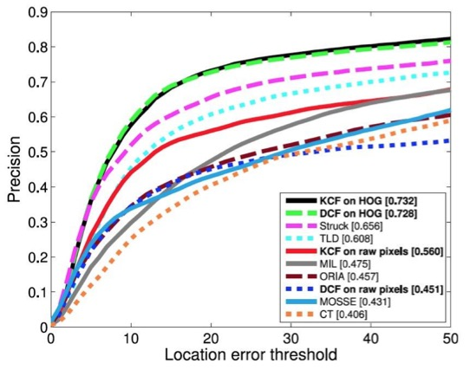
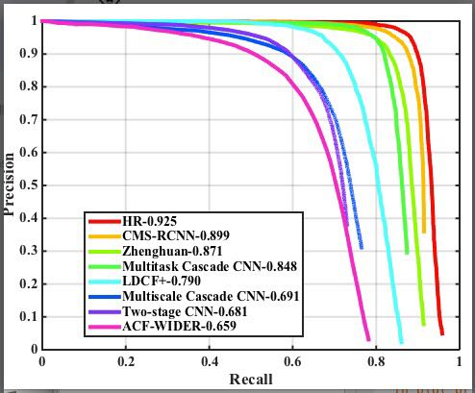
Concept Generation & Selection
Pure tracking
KCF
Pure detection
Fast R-CNN
dlib

Slide 8
Concept Generation & Selection
Combined score function
Detection assisted tracking
Mixed ranking
Balance between two algorithms
Smooth trace

Slide 9
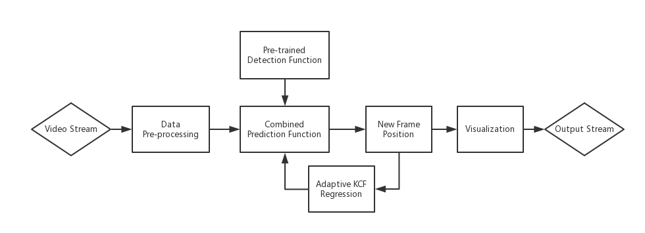
Final Design Overview

Slide 10
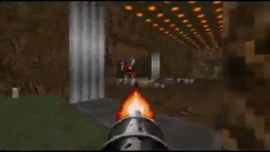
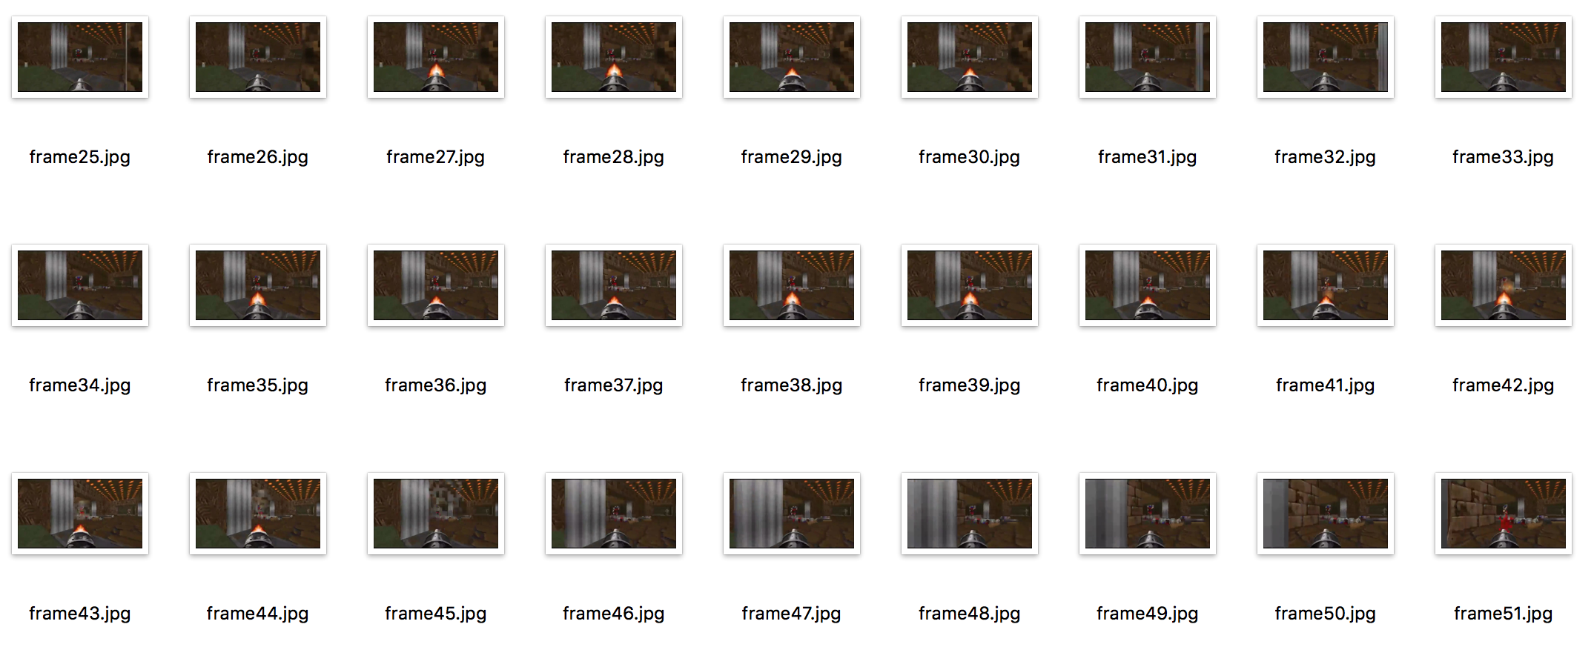
Final Design Input Processing
Real-time Stream
Frames

Slide 11
Final Design Face Detection
GPU Mode:
Faster R-CNN
Faster Region-based Convolutional Neural Network
High Accuracy
High speed with GPU (~100fps)
Low speed on CPU (~1fps)
CPU Mode:
Dlib Detection
Deep Metric Learning
Lower Accuracy
High speed on CPU (~30fps)\
Open source Library

Slide 12
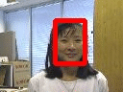
Final Design Tracking
Based Algorithm
KCF Tracking
Kernelized Correlation Filter
High speed online learning regression model (~172fps)
High object tracking accuracy (>73.2%)

Slide 13
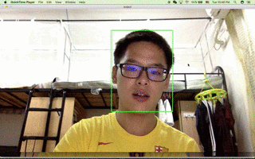
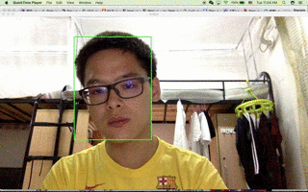
Final Design Tracking with Detection
Use face detection to ensure that we always track people when there is one
Use tracker to keep tracking under occultation & black out
Solve:
Focus lose
Illumination variant
Occultation

Slide 14
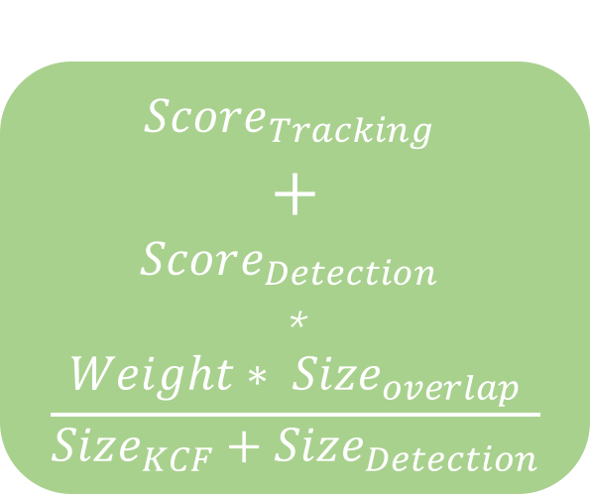
Final Design Tracking with Detection
Sequence Control
$$Score_{Tracking}$$
$$+$$
$$Score_{Detection}$$
*
$$\frac{{Weight∗ Size}_{overlap}}{Size_{KCF}+Size_{Detection}}$$
Detection Results top#50
New location
Tracking Results top#50
KCF regression

Slide 15
Prototype
Language: Python
Package use:
Open-CV: For live stream processing & visualization
MxNet: For Faster-RCNN training
Dlib: For dlib face detection
Modification based on the python implementation of KCF
Parameters: mostly determined during experiments

Slide 16
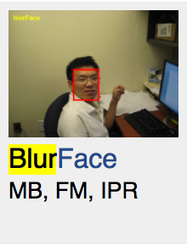
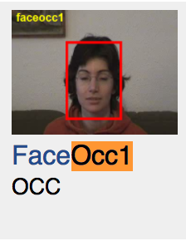
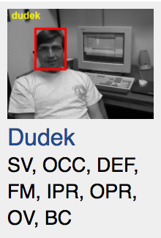
Test Result Testing Data
No benchmark for in-car object tracking
Instead, we use Visual Tracker Benchmark
Only face tracking sequences
OCC: Occlusion – the target is partially or fully occluded.
FM: Fast Motion – the motion of the ground truth is larger than tm pixels (tm=20).
MB: Motion Blur – the target region is blurred due to the motion of target or camera.
OV: Out-of-View – some portion of the target leaves the view.
BC:Background Clutters – the background near the target has the similar color or texture as the target.

Slide 17

Test Results Method
Overlapping ratio: $\frac{overlap(predict region, ground truth)}{smaller(predict region, ground truth)}$
Success Rate: # % of frames that success the overlapping ratio

Slide 18
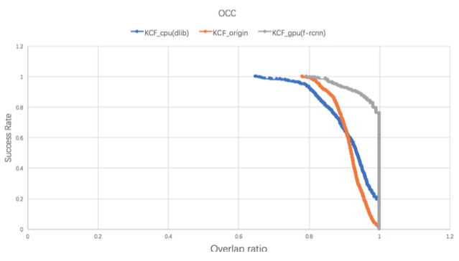
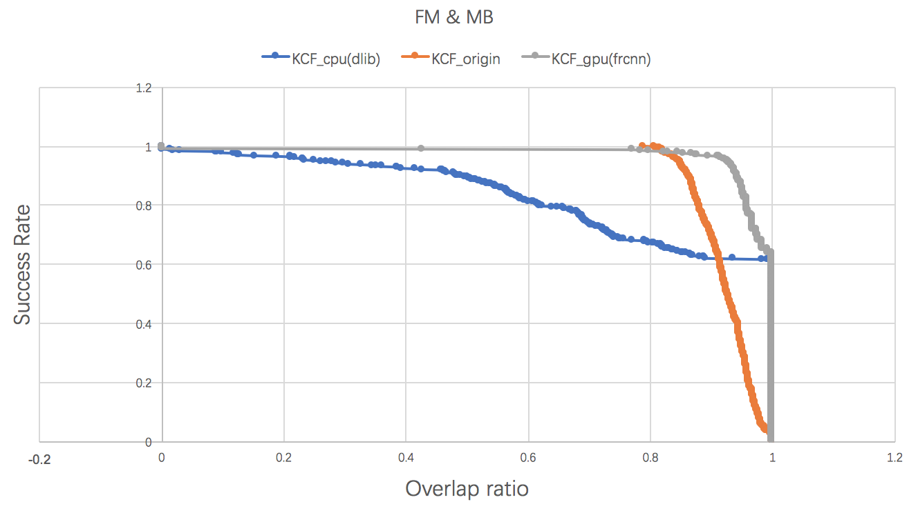
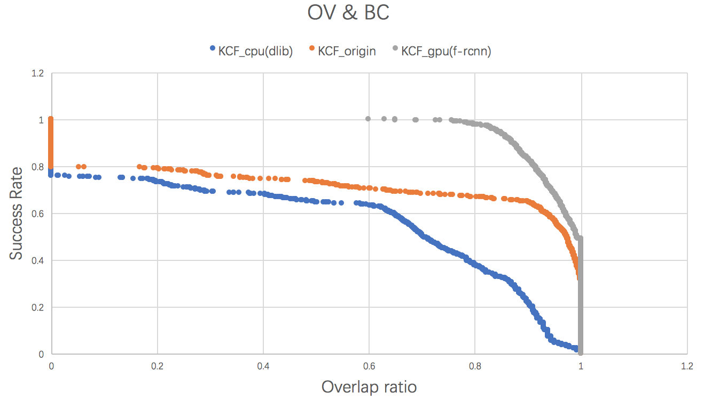
Test Results Result
Figure 9.1.1 Success rate vs. overlap ratio in OCC test
OCC: Occlusion – the target is partially or fully occluded.
Figure 9.1.2 Success rate vs. overlap ratio in FM & MB test
FM: Fast Motion – the motion of the ground truth is larger than tm pixels (tm=20). MB: Motion Blur – the target region is blurred due to the motion of target or camera.
Figure 9.1.3 Success rate vs. overlap ratio in OV & BC test
OV: Out-of-View – some portion of the target leaves the view. BC:Background Clutters – the background near the target has the similar color or texture as the target.

Slide 19
Test Results Comparison
Generally, GPU version performs best when deployed on GPU
CPU version is still worthy of mention for in-car system use.
 | KCF_cpu | KCF origin | KCF_gpu
FPS (24) | ~50 | 172 | ~50 with gpu; ~1 with cpu
Frame Loss rate | 7% | 6% | 1%
Precision (70%) (under 60% overlap ratio) | 76% | 86% | 95%
Variance (10%) | 3.4% | 3% | 0.3%

Slide 20
Q&A

